Slide 1
Coursera Capstone
Data Science Project

Slide 2
Introduction/Business Problem
For this project, restaurants in a NYC neighborhood will be analyzed. The goal of the project is to find a neighborhood to start a restaurant that is not overly saturated with similar restaurants.
For example, investing in a Chinese restaurant in China town where there are numerous Chinese restaurants may not be successful.
However, if in another neighborhood there are no Chinese restaurants, this neighborhood could make for a great investment.

Slide 3
Data Section
The NYC json file will be downloaded. This file has the neighborhood and borough data.
From the NYC neighborhoods, a specific neighborhood will be selected in order to analyze the prospects of specific types of restaurants.
Once the neighborhood is selected, Foursquare will be used to determine the types of restaurants in this neighborhood. Neighborhood population data will also be utilized in order to ensure an adequate population to support another restaurant.
Using these data types, a specific type of restaurant will be proposed for this neighborhood.¶

Slide 4
Methodology section
For this project, Foursquare was used in order to pull restaurant data in specific neighborhoods. This information will be analyzed in order to find a potential new restaurant in a specific neighborhood.
The use of neighborhood population data was to be used, however consistent neighborhood data that matched up with the NYC JSON file was difficult to obtain.
After drilling down into a few neighborhoods, a choice was made in order to move forward on a BBQ Joint type of restaurant.

Slide 5
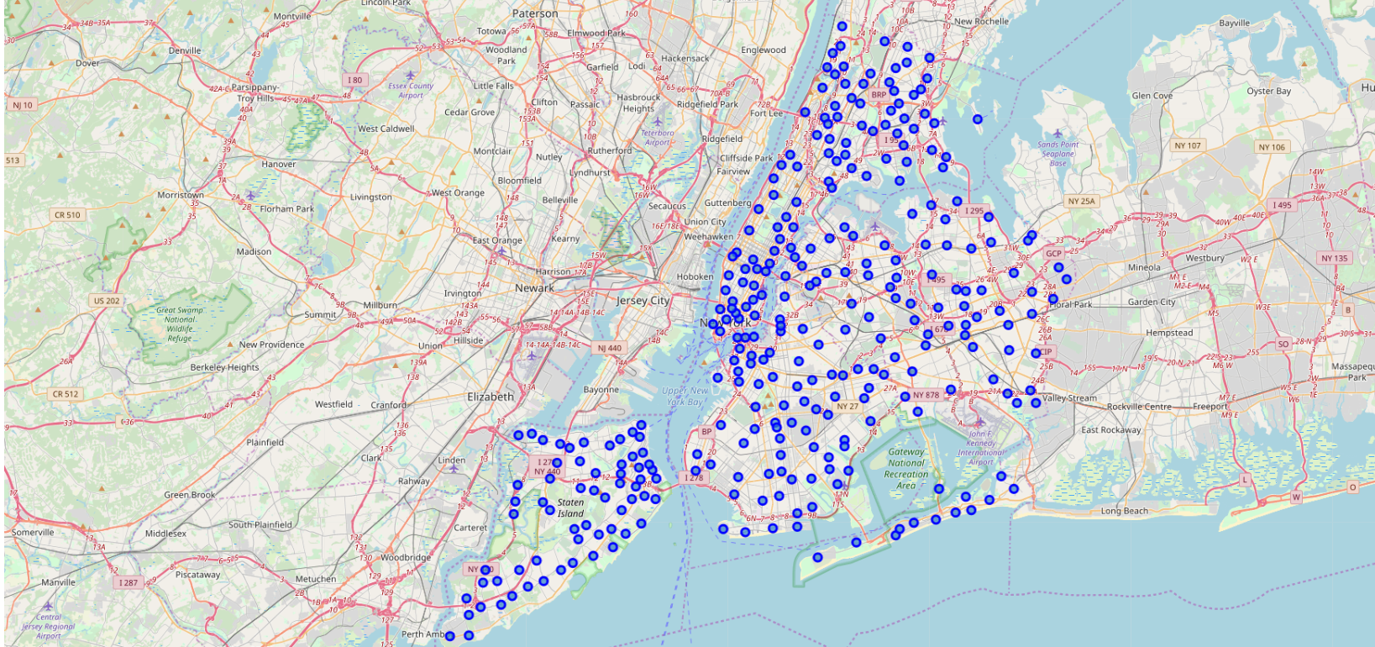
NYC Neighborhoods

Slide 6
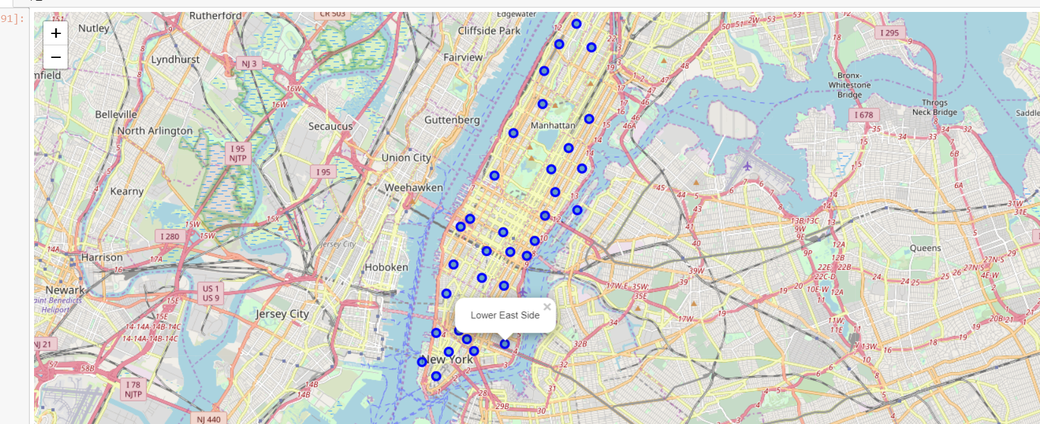
Manhattan Neighborhoods – the focus of this project

Slide 7
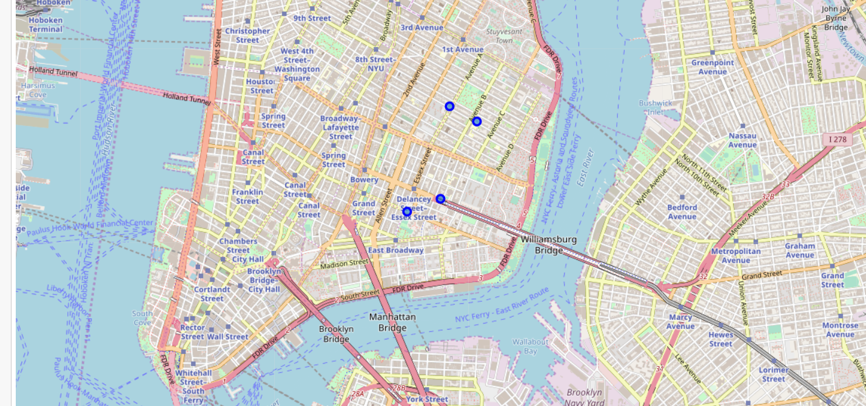
Lower East Side - Locations of current BBQ Restaurants

Slide 8
Analysis and Results
Two of these BBQ Joints have very limited likes. Therefore, opening a BBQ Joint in the Lower East Side neighborhood could have a good opportunity for success.
Since there are only 4 total BBQ restaurants, and only 2 have a high number of likes, prospects are good that another BBQ Joint could be successful in this neighborhood.

Slide 9
Discussion
A number of iterations were needed due to the fact that Foursquare returns a large number of data points that are not associated with the category ID's used with Foursquare.

Slide 10
Conclusion
As a beginning learner in Data Science and Python, this was a very fun and challenging project.
This project showed the power of Data Science and how it can be applied to real world business analytics.
The ability to pull crowdsourced information from Foursquare, or any other provider, is providing businesses with outstanding tools to grow.

